Slide 1
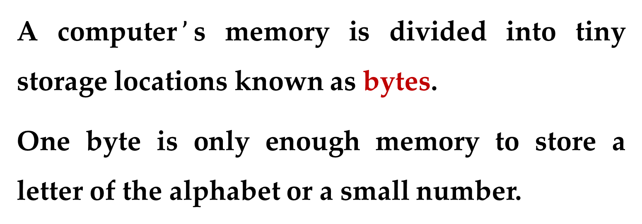
Concept:
All data that is stored in a computer is converted to sequences of 0s and 1s.
A computer$’$s memory is divided into tiny storage locations known as bytes.
One byte is only enough memory to store a letter of the alphabet or a small number.
How Computers Work

Slide 2
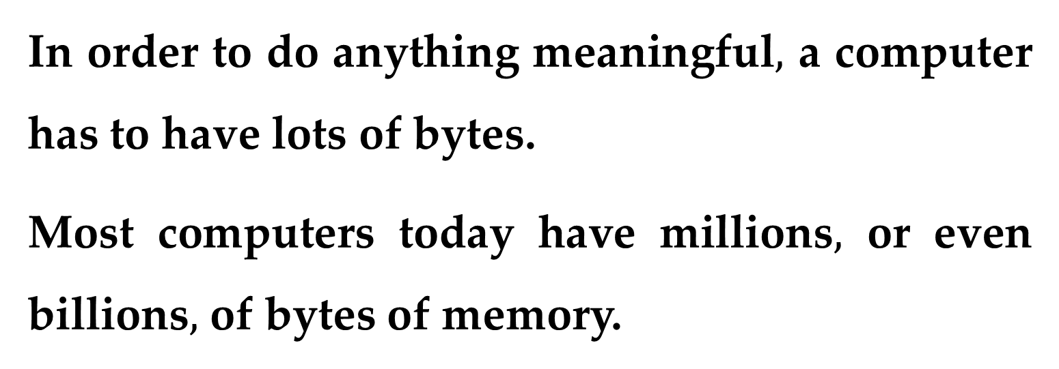
In order to do anything meaningful$,$ a computer has to have lots of bytes.
Most computers today have millions$,$ or even billions$,$ of bytes of memory.
Each byte is divided into eight smaller storage locations known as bits.
The term bit stands for binary digit.
How Computers Work

Slide 3
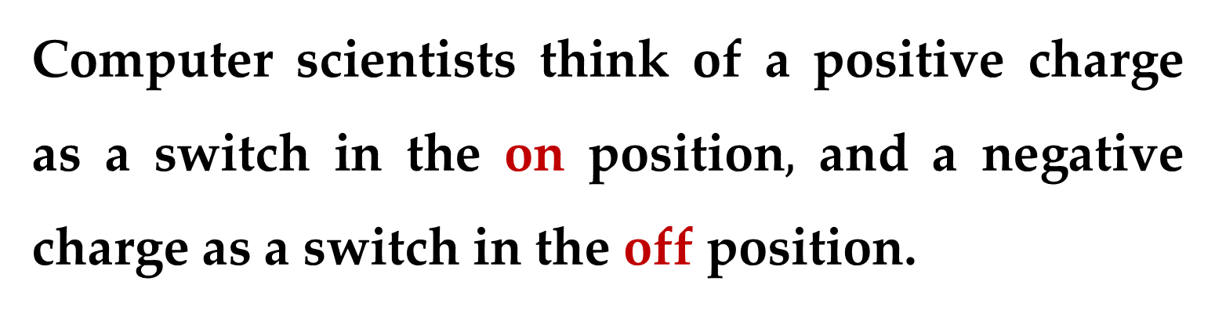
Computer scientists usually think of bits as tiny switches that can be either on or off.
In most computer systems, bits are tiny electrical components that can hold either a positive or a negative charge.
Computer scientists think of a positive charge as a switch in the onposition$,$ and a negative charge as a switch in the offposition.
How Computers Work

Slide 4
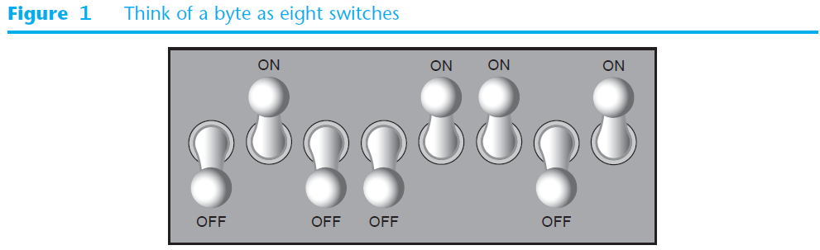
Figure 1 shows the way that a computer scientist might think of a byte of memory:
as a collection of switches that are each flipped to either the on or off position.
How Computers Work

Slide 5
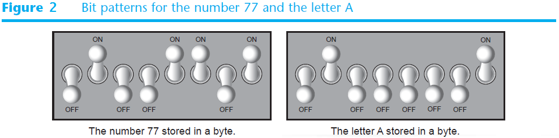
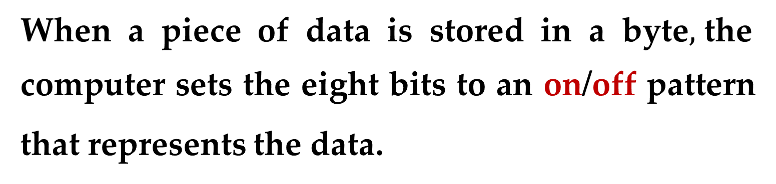
When a piece of data is stored in a byte$,$the
computer sets the eight bits to an on/offpattern that represents the data.
The pattern on the left in Figure 2 shows how the number 77 would be stored in a byte.
The pattern on the right shows how the letter A would be stored in a byte.

Slide 6
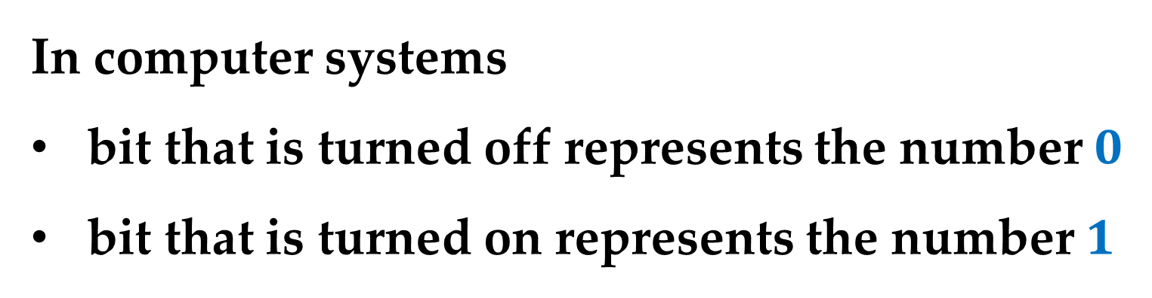
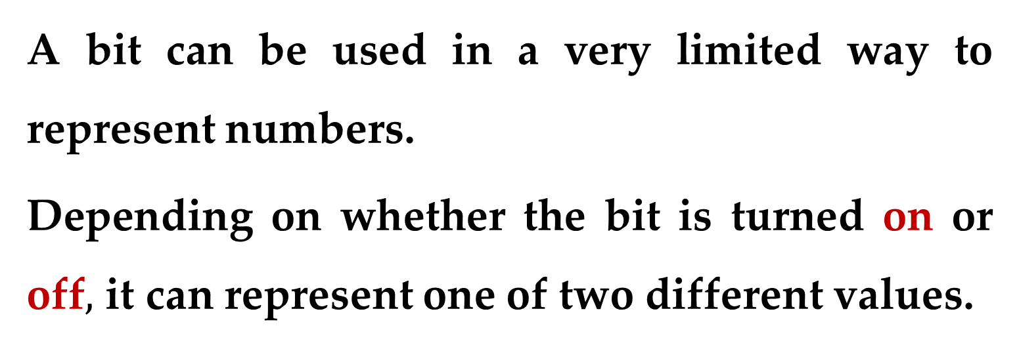
A bit can be used in a very limited way to represent numbers.
Depending on whether the bit is turned on or off$,$ it can represent one of two different values.
In computer systems
bit that is turned off represents the number $0$
bit that is turned on represents the number $1$
How Computers Work

Slide 7
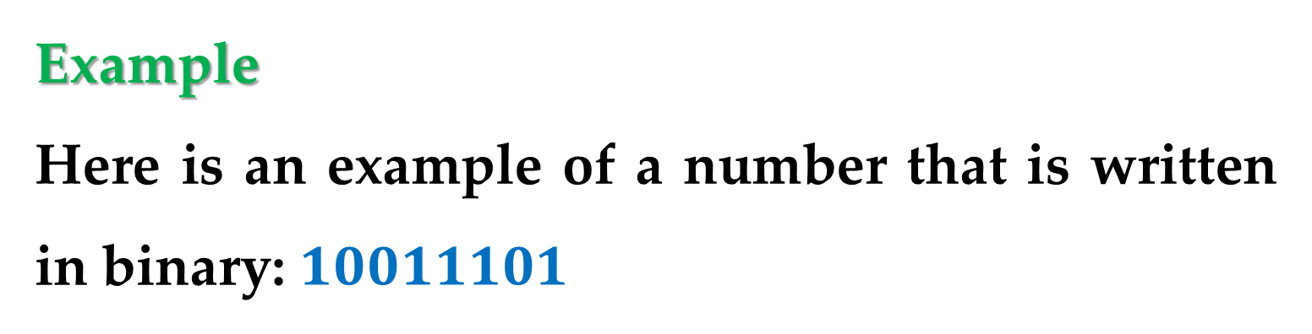
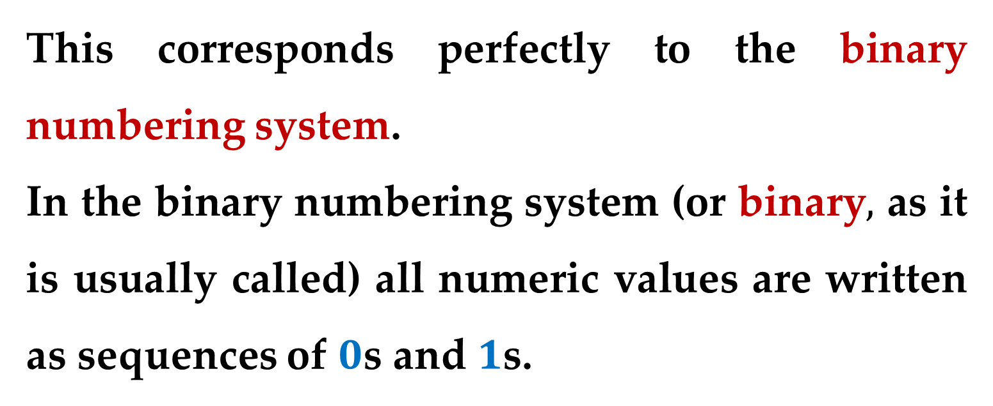
This corresponds perfectly to the binary numbering system.
In the binary numbering system (or binary$,$ as it is usually called) all numeric values are written as sequences of $0$s and $1$s.
Example
Here is an example of a number that is written in binary: $10011101$
Storing Numbers

Slide 8
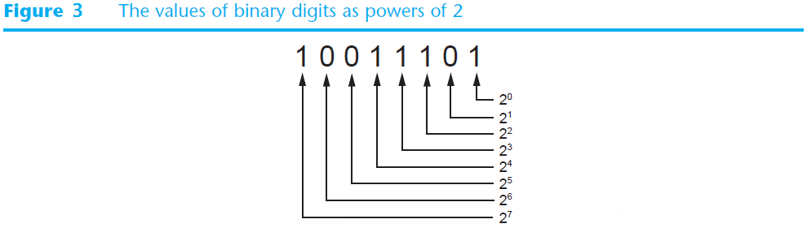
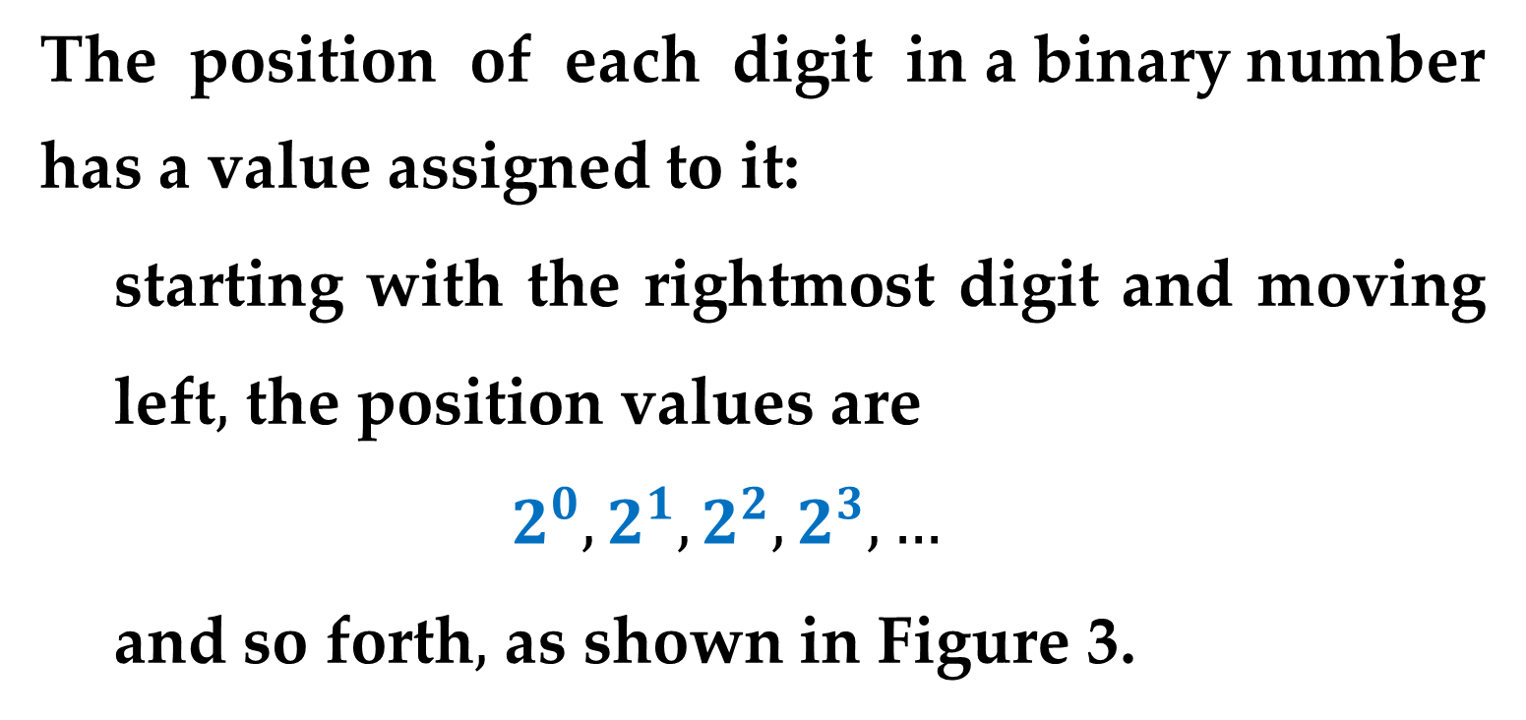
The position of each digit in a binary number
has a value assigned to it:
starting with the rightmost digit and moving left$,$ the position values are
$$2^{0},2^{1},2^{2},2^{3},…$$
and so forth$,$ as shown in Figure 3.

Slide 9
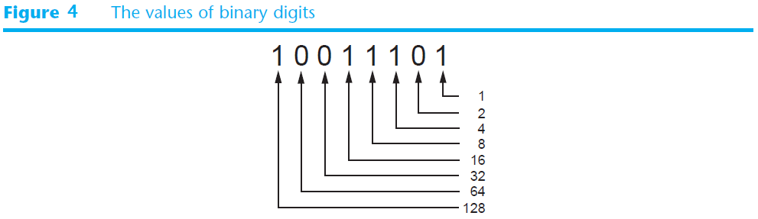
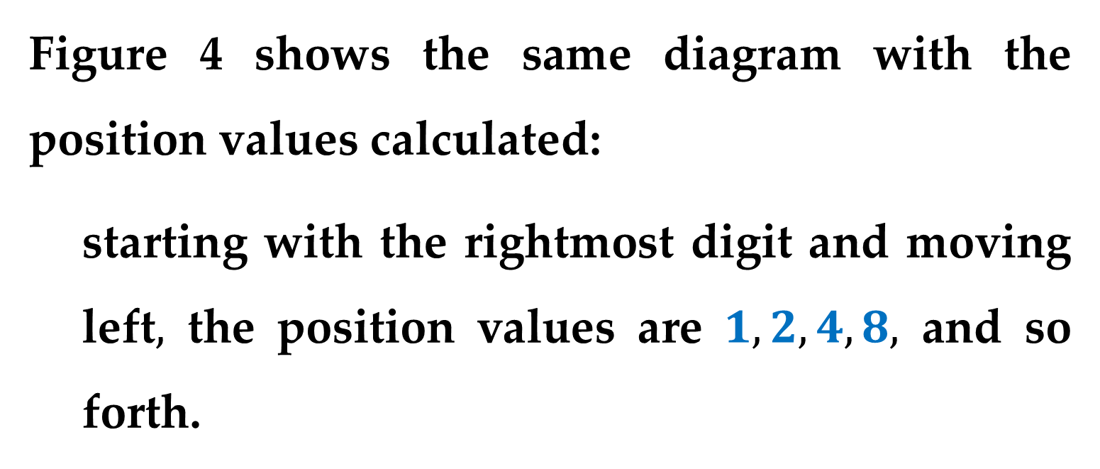
Figure 4 shows the same diagram with the position values calculated:
starting with the rightmost digit and moving left$,$ the position values are $1, 2, 4, 8,$ and so forth.

Slide 10
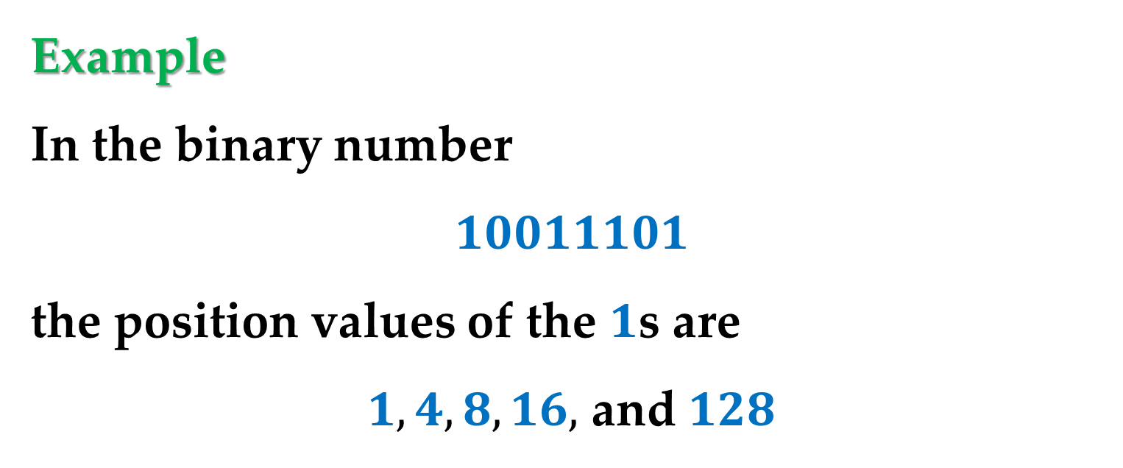
To determine the value of a binary number you simply add up the position values of all the 1s.
Example
In the binary number
$$10011101$$
the position values of the $1$s are
$1, 4, 8, 16,$ and $128$
Storing Numbers

Slide 11
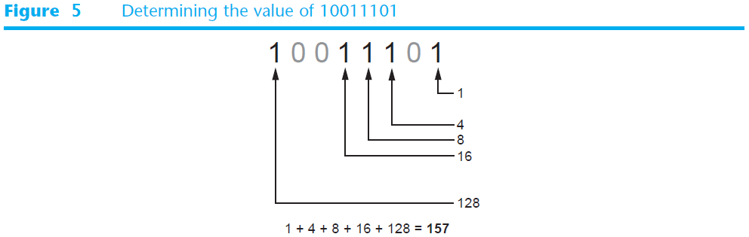
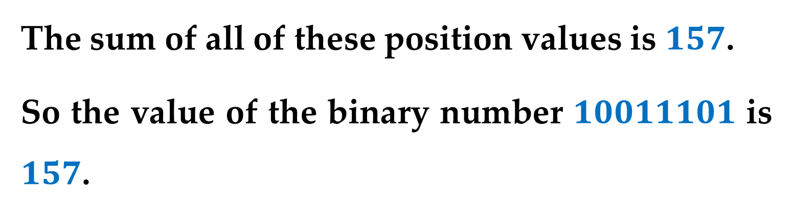
The sum of all of these position values is $157$.
So the value of the binary number $10011101$ is $157$.
Storing Numbers

Slide 12
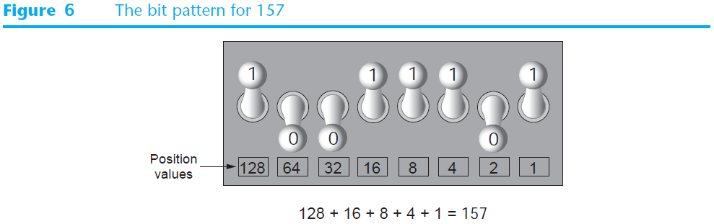
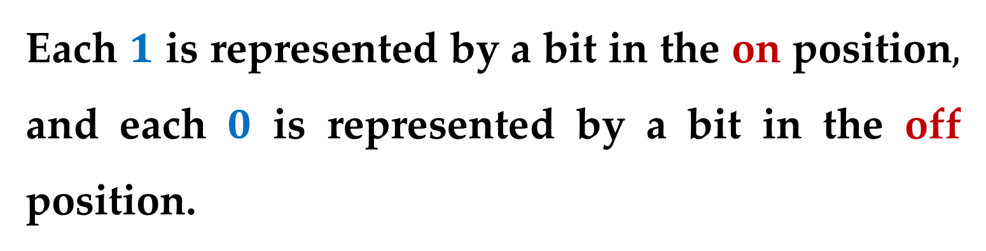
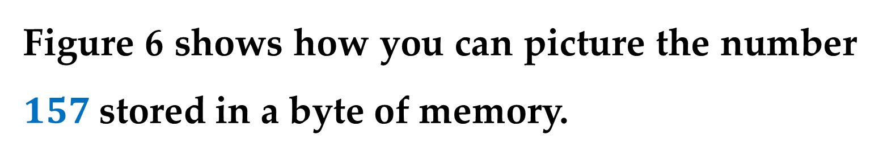
Figure 6 shows how you can picture the number $157$stored in a byte of memory.
Each $1$is represented by a bit in the on position$,$ and each $0$ is represented by a bit in the off position.
Storing Numbers

Slide 13
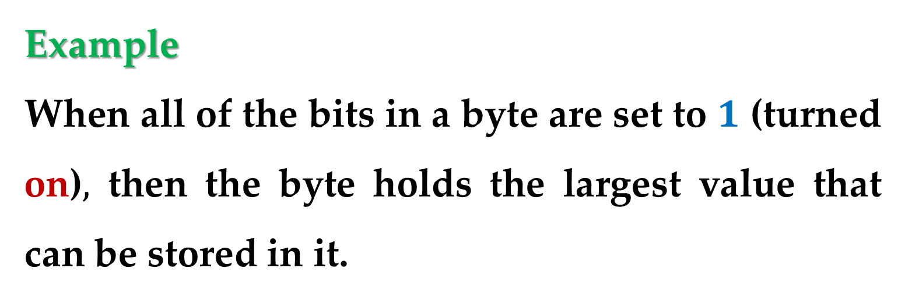
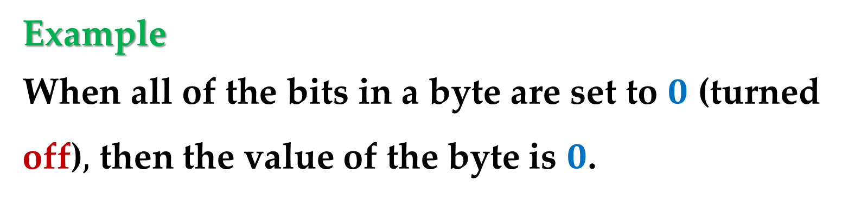
Example
When all of the bits in a byte are set to $0$ (turned off)$,$ then the value of the byte is $0$.
Example
When all of the bits in a byte are set to $1$ (turned on)$,$ then the byte holds the largest value that can be stored in it.
Storing Numbers

Slide 14
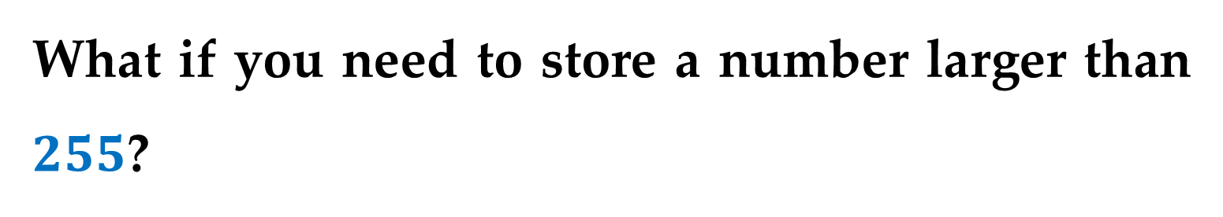
What if you need to store a number larger than $255$?
The answer is simple: use more than one byte.
Storing Numbers

Slide 15
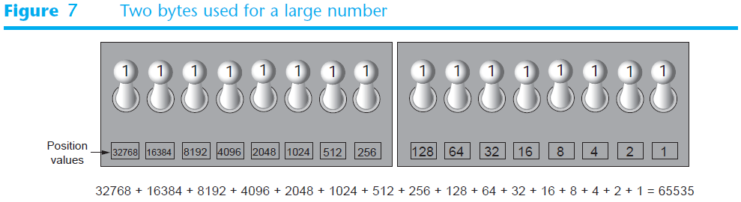
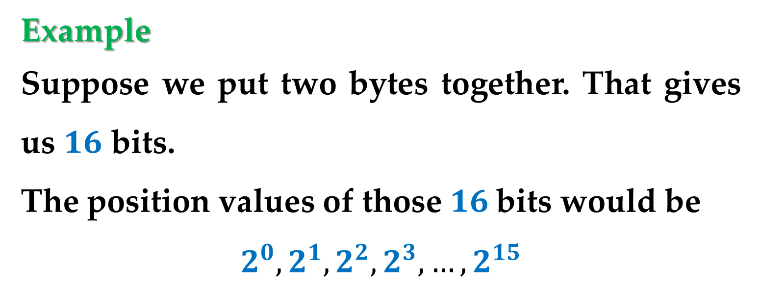
Example
Suppose we put two bytes together. That gives us $16$ bits.
The position values of those $16$bits would be
$$2^{0}, 2^{1}, 2^{2}, 2^{3},…,2^{15}$$
Storing Numbers

Slide 16
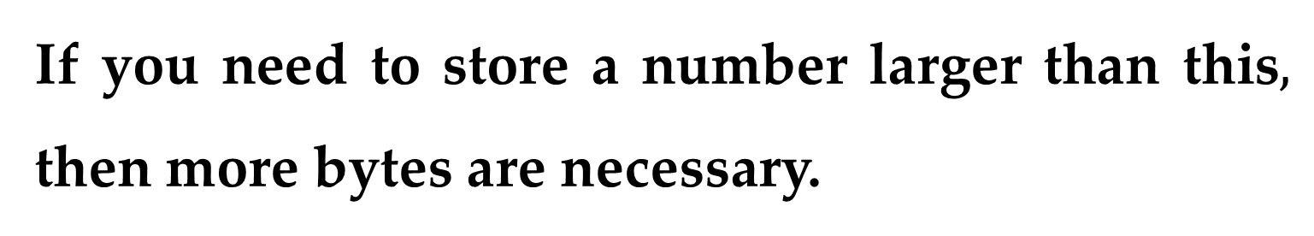
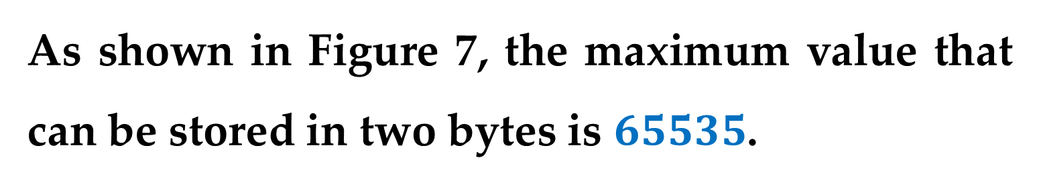
As shown in Figure 7, the maximum value that can be stored in two bytes is $65535$.
If you need to store a number larger than this$,$ then more bytes are necessary.
Storing Numbers

Slide 17
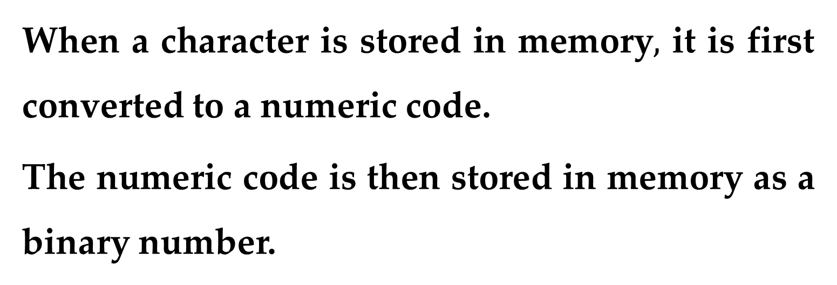
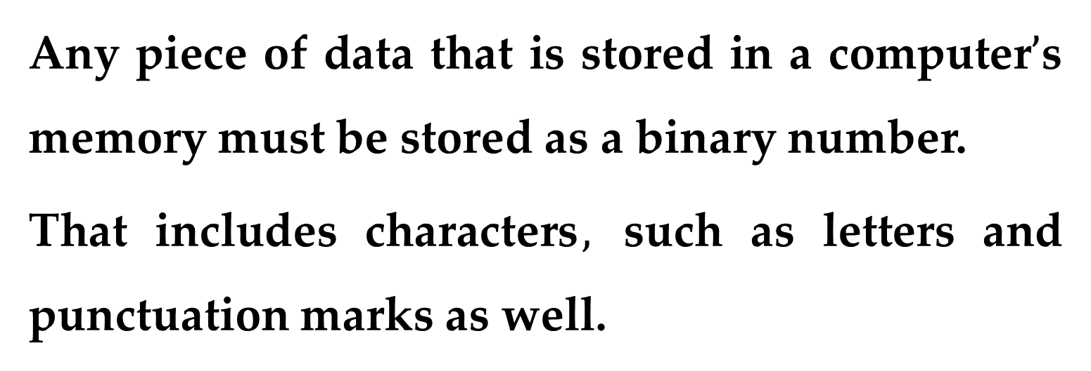
Any piece of data that is stored in a computer$’$s memory must be stored as a binary number.
That includes characters$,$ such as letters and punctuation marks as well.
When a character is stored in memory$,$ it is first converted to a numeric code.
The numeric code is then stored in memory as a binary number.
Storing Characters

Slide 18
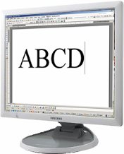
Text file
on the screen (symbols)
in memory - codes
1000001₂ | 1000010₂ | 1000011₂ | 1000100₂
65 | 66 | 67 | 68
!
The file does not store images of symbols, but their numeric codes!
Font files: *.fon, *.ttf, *.otf

Slide 19
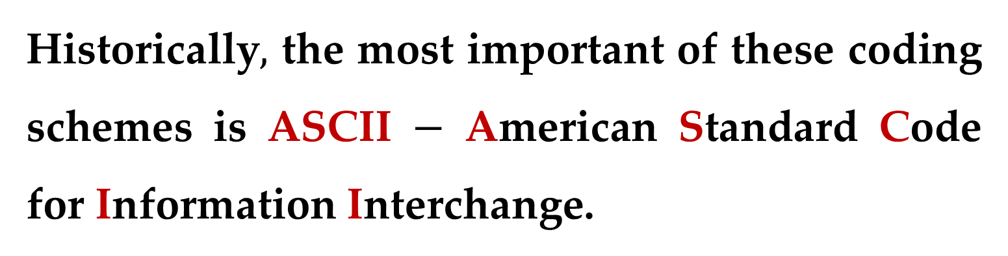
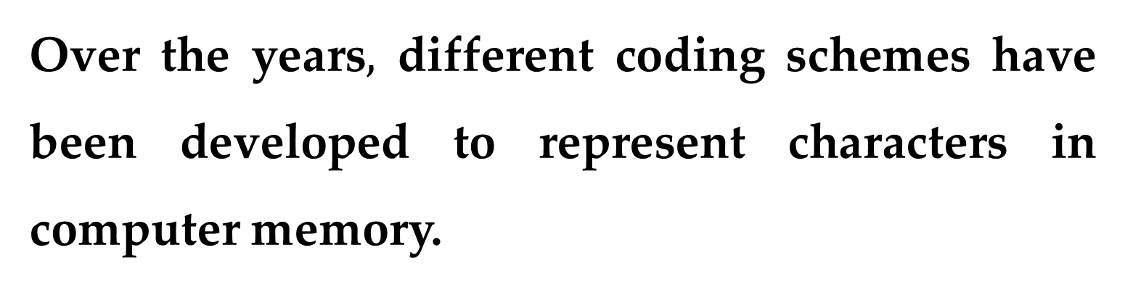
Over the years$,$ different coding schemes have been developed to represent characters in computer memory.
Historically$,$ the most important of these coding schemes is ASCII $−$American Standard Code for Information Interchange.
Storing Characters

Slide 20
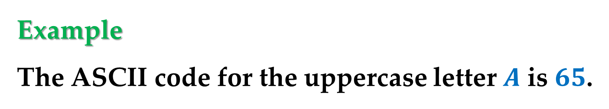
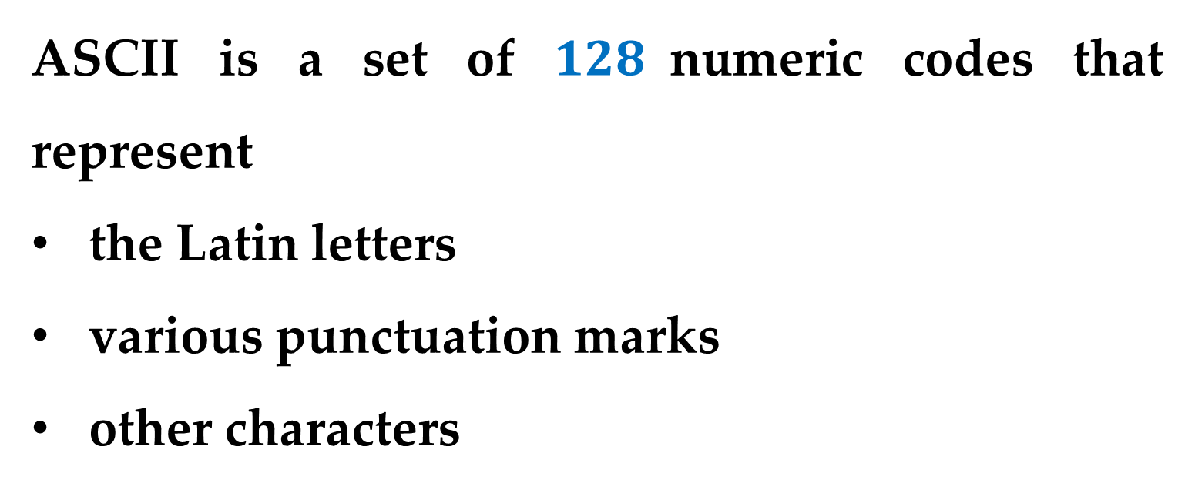
ASCII is a set of $128$numeric codes that represent
the Latin letters
various punctuation marks
other characters
Example
The ASCII code for the uppercase letter $A$ is $65$.
Storing Characters

Slide 21
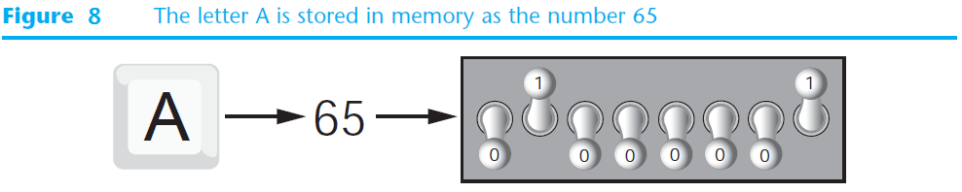
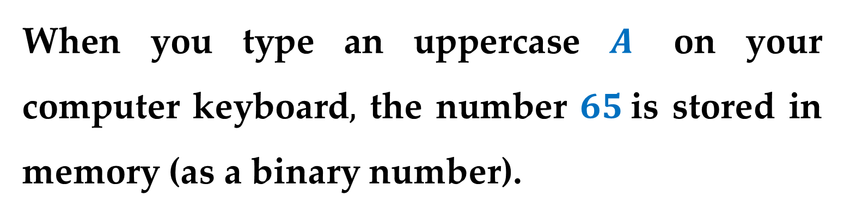
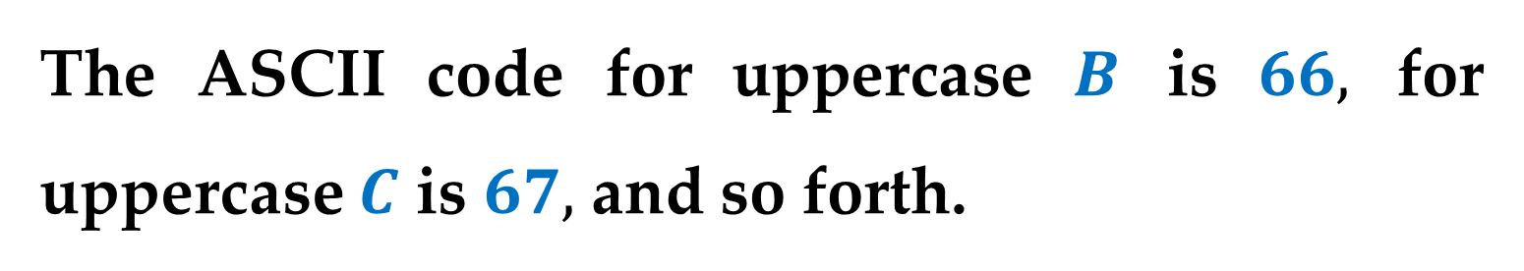
When you type an uppercase $A$ on your computer keyboard$,$ the number $65$is stored in memory (as a binary number).
This is shown in Figure 8.
The ASCII code for uppercase $B$ is $66,$ for uppercase $C$ is $67,$ and so forth.

Slide 22
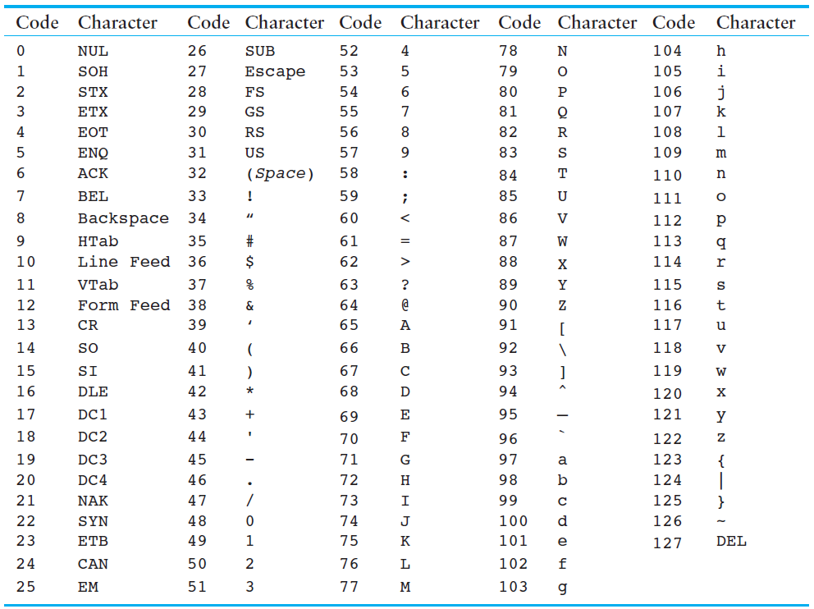
Storing Characters

Slide 23
8 bit encoding
Code Pages (ASCII Extensions):
0 | 1
127 | 128
254 | 255
 |  |  |  |  | national alphabet
ASCII table

Slide 24
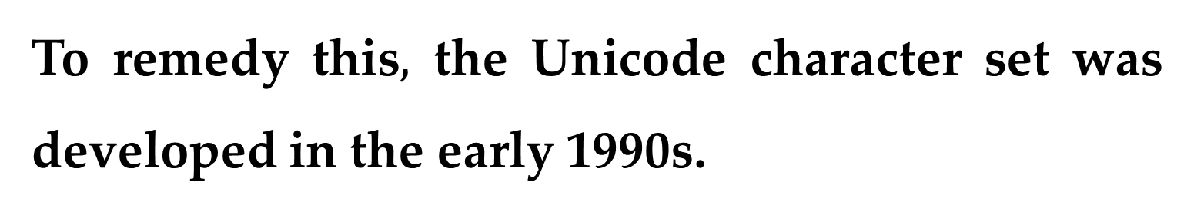
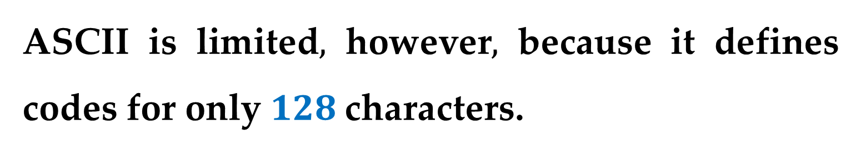
The ASCII character set was developed in the early 1960s and was eventually adopted by most all computer manufacturers.
ASCII is limited$,$ however$,$ because it defines codes for only $128$characters.
To remedy this$,$ the Unicode character set was developed in the early 1990s.
Storing Characters

Slide 25
Many of today’s systems embrace Unicode, a 16-bit system that can encode the characters of every language in the world.
The Java programming language, and some operating systems now use Unicode as their default character code.
The Unicode codespace is divided into six parts. The first part is for Western alphabet codes, including English, Greek, and Russian.

Slide 26
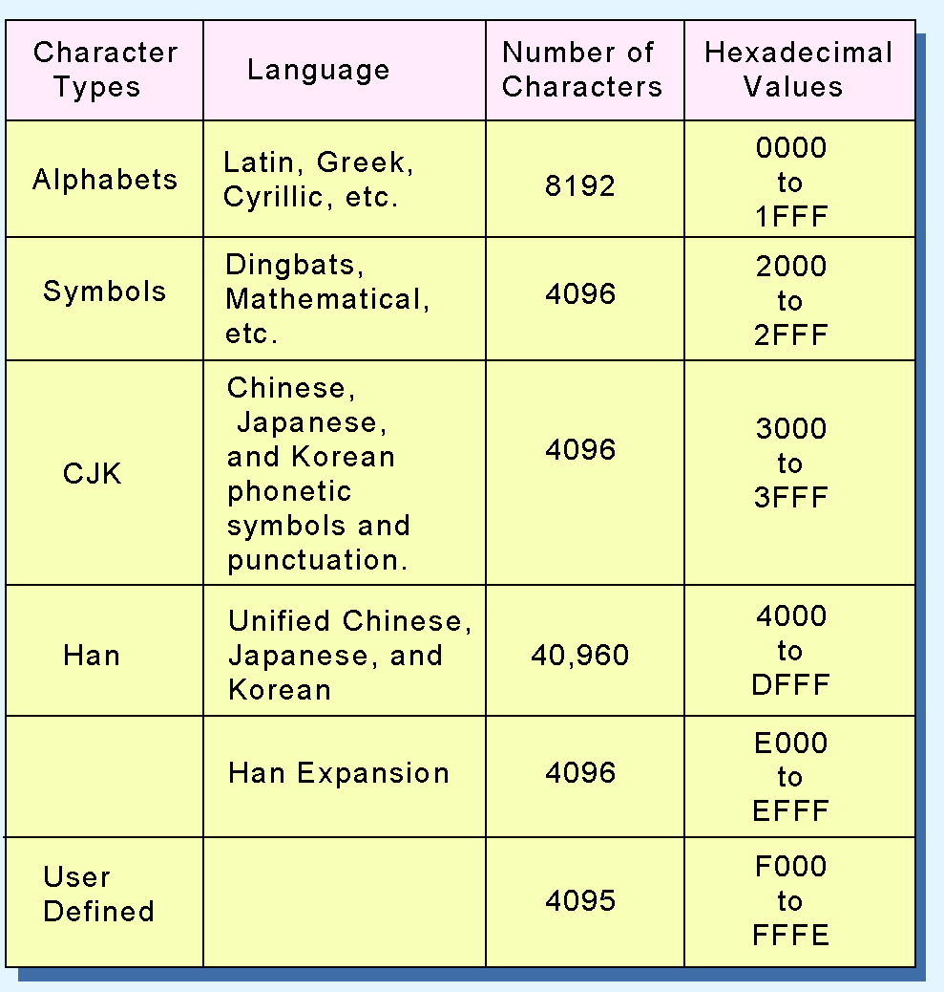
The Unicode code
space allocation is shown at the right.
The lowest-numbered Unicode characters comprise the ASCII code.
The highest provide for user-defined codes.

Slide 27
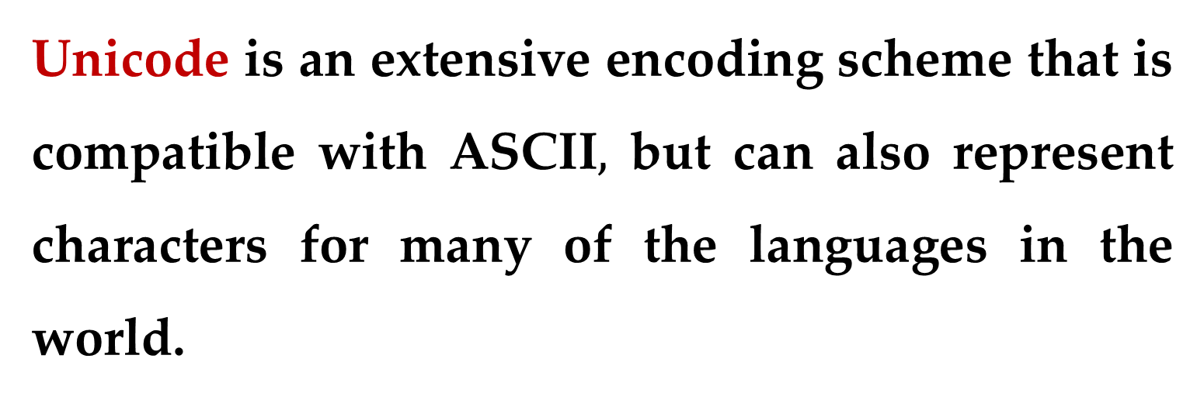
Unicode is an extensive encoding scheme that is compatible with ASCII$,$ but can also represent characters for many of the languages in the world.
Storing Characters

Slide 28
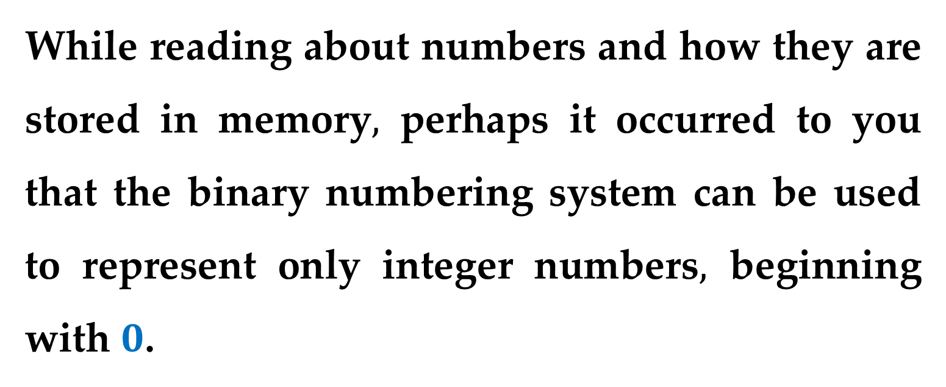
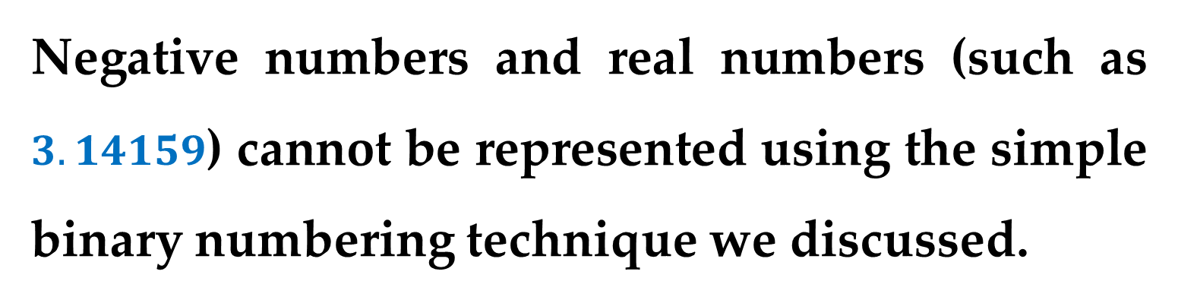
While reading about numbers and how they are stored in memory$,$perhaps it occurred to you that the binary numbering system can be used to represent only integer numbers$,$ beginning with $0$.
Negative numbers and real numbers (such as $3.14159$) cannot be represented using the simple binary numbering technique we discussed.
Advanced Number Storage

Slide 29
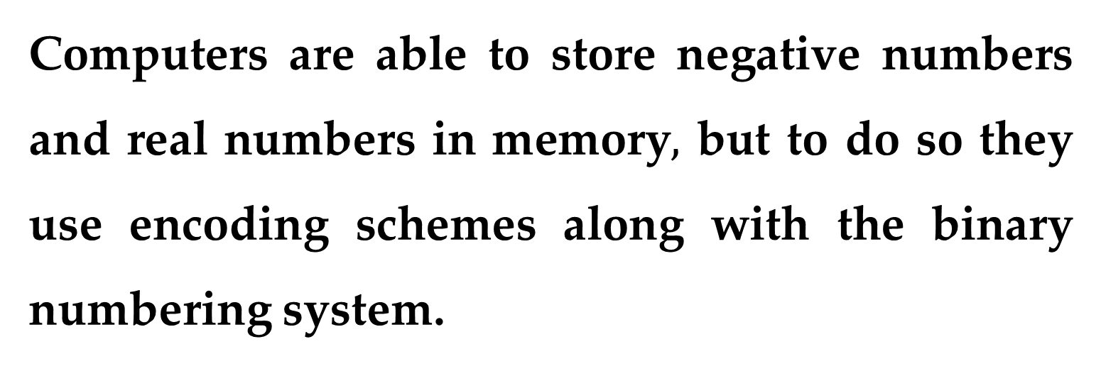
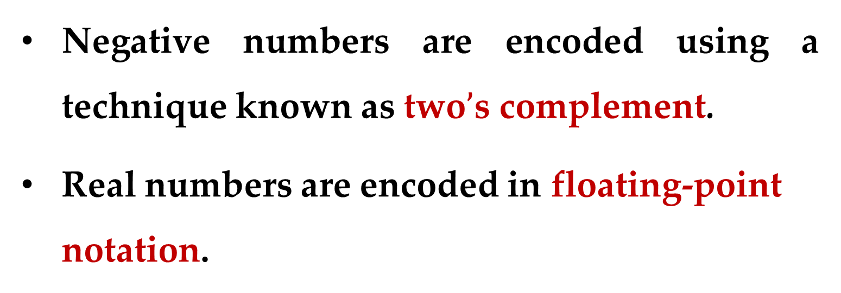
Computers are able to store negative numbers and real numbers in memory$,$ but to do so they use encoding schemes along with the binary numbering system.
Negative numbers are encoded using a technique known as two$’$s complement.
Real numbers are encoded in floating-point notation.
Advanced Number Storage

Slide 30
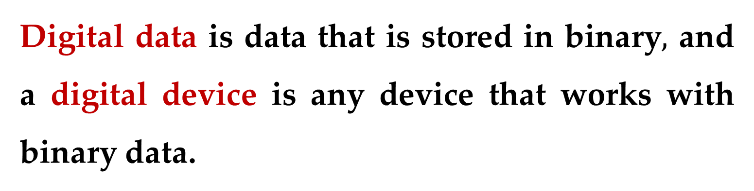
Computers are often referred to as digital devices.
The term digital can be used to describe anything that uses binary numbers.
Digital datais data that is stored in binary$,$ and a digital device is any device that works with binary data.
Other Types of Data

Slide 31
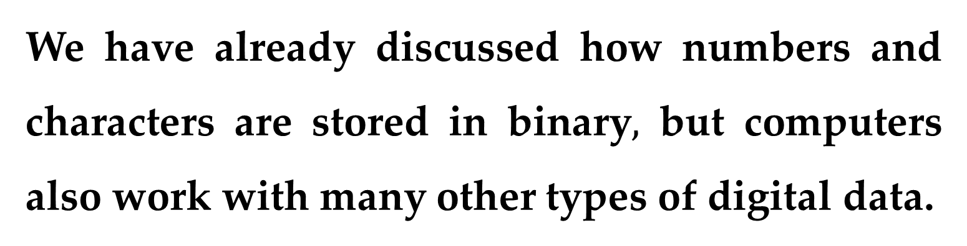
We have already discussed how numbers and characters are stored in binary$,$ but computers also work with many other types of digital data.
Example
Consider the pictures that you take with your digital camera. These images are composed of tiny dots of color known as pixels. (The term pixel stands for picture element.)
Other Types of Data

Slide 32
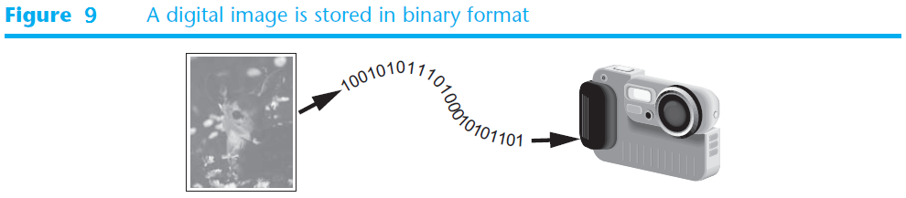
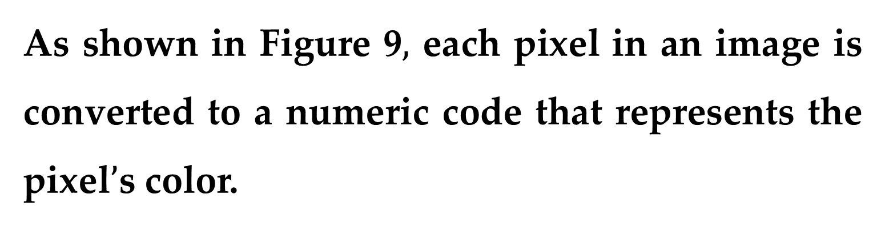
As shown in Figure 9$,$each pixel in an image is converted to a numeric code that represents the pixel$’$s color.
The newly generated binary code is then stored in memory as a binary number.
Other Types of Data

Slide 33


The music that you play on your CD player$,$ iPod$,$ or MP3 player is also digital. A digital song is broken into small pieces known as samples.
Each sample is converted to a binary number$,$ which can be stored in memory. The more samples that a song is divided into$,$the more it sounds like the original music when it is played back.
Other Types of Data

Slide 34
Thank You for Attention

